Slide 1


#LifeKoKaroLift
Working with Git & Github
1

Slide 2




Course : Machine Learning
EEditdit MasterMaster texttext ststylyleses
Lecture On : Git & GitHub
Instructor : Siddhesh Gunjal
2

Slide 3
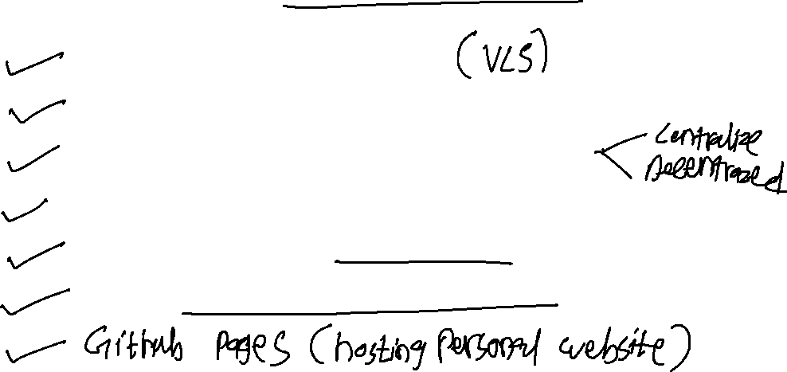
In this session, we will cover..
Version Control System
Why we need Version Control System
Types of Version Control System
Version Control Tools
Git and GitHub: What & Why
Git operations and commands

Slide 4


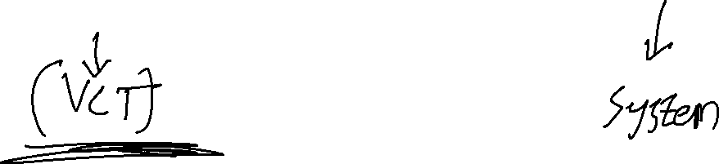
&

Slide 5
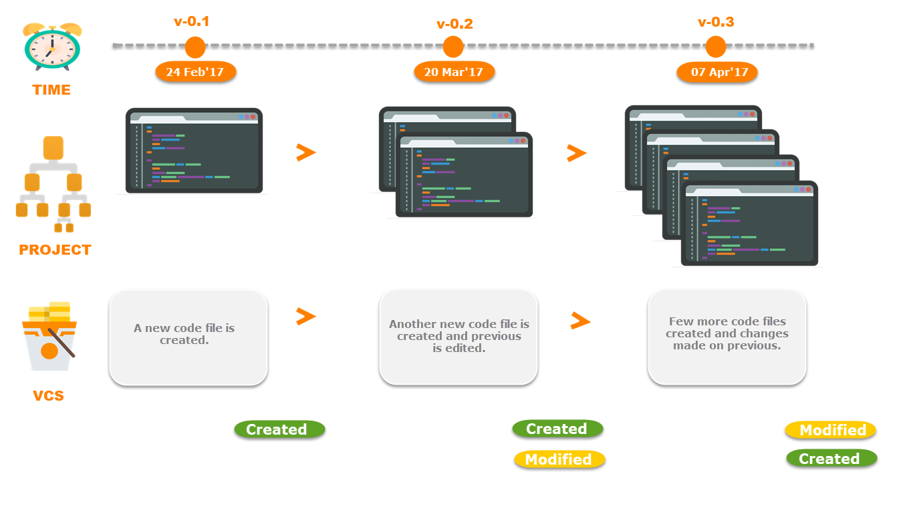

Version Control System

Slide 6
Why do we need Version Control System?

Slide 7


Problems
Had code that worked, made a bunch of changes and saved it, which broke the code, and now you just want the working version back…
Accidentally deleted a critical file, hundreds of lines of code gone…
Somehow messed up the structure/contents of your code base, and want to just “undo” the crazy action you just did!
Hard drive crash!!!! Everything’s gone, the day before deadline!
Whose computer stores the "official" copy of the project?
Will we be able to read/write each other's changes?
Lets just email changed files back and forth! Yay!
What happens if we both try to edit the same file?
What happens if we make a mistake and corrupt an important file?
How do I know what code each teammate is working on?
How do we know who added this code piece?
I didn’t do it …. Raju!!!

Slide 8

Collaboration
Before
After
Task 1
Task 1
+
Task 2
+
Task 3
Task 2
Task 3
Common Repository

Slide 9
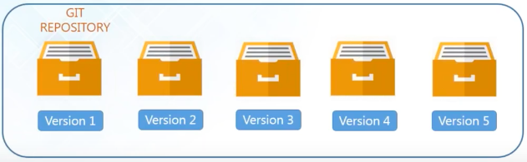

Storing Versions
All changes made in every versions are properly documented and stored.
Versions are also named accurately

Slide 10
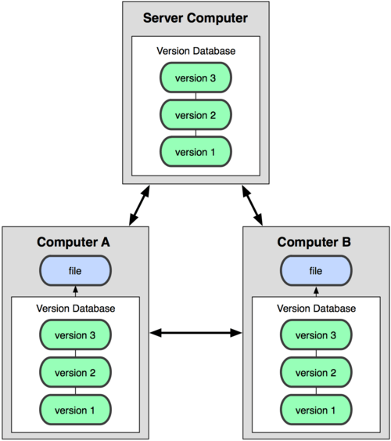

Backup

Slide 11

Track Changes
When You change the Version:
Provides you with proper description
What exactly was change
When it was changed

Slide 12
Types of Version Control System

Slide 13
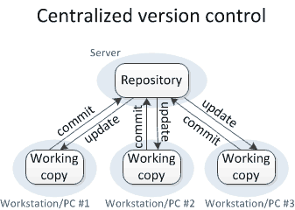

Slide 14
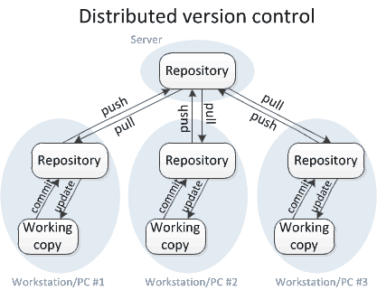
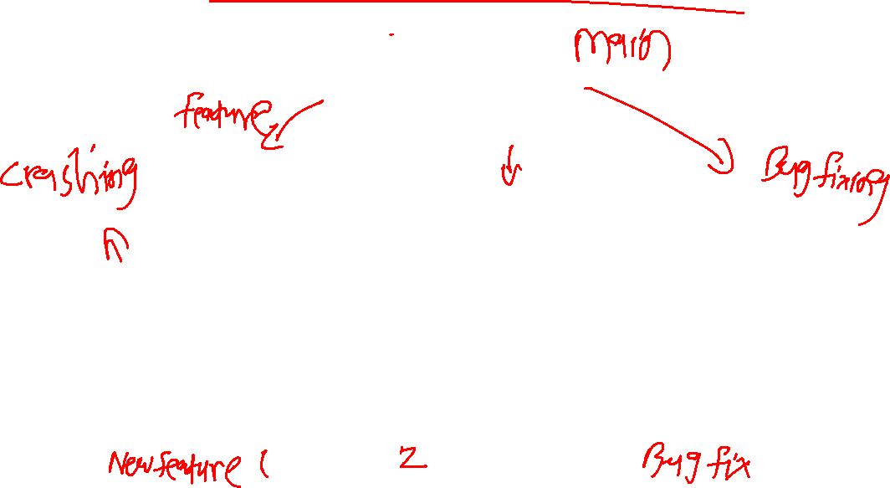

Slide 15
Version Control Tools

Slide 16





Slide 17
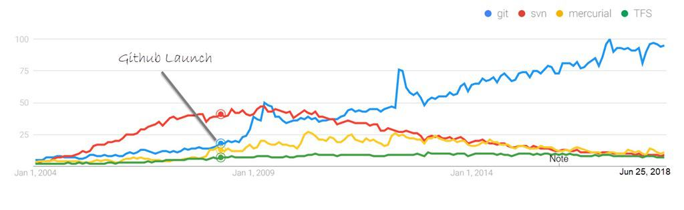


Why Git ?
Image Reference
Git came into existence because of a controversy between Linux developers and BitKeeper. It was developed by Linus Torvald who was the main developer of the Linux kernel, used by Linux distributions.

Slide 18
Git & GitHub: What & Why?

Slide 19
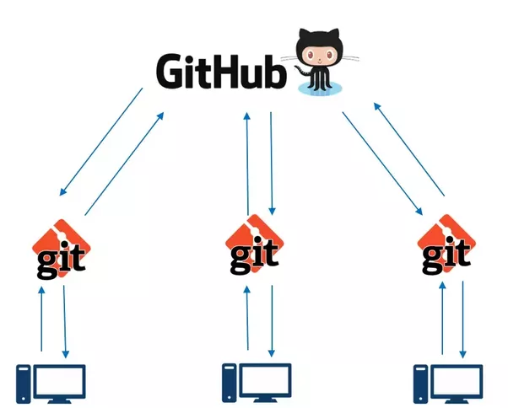
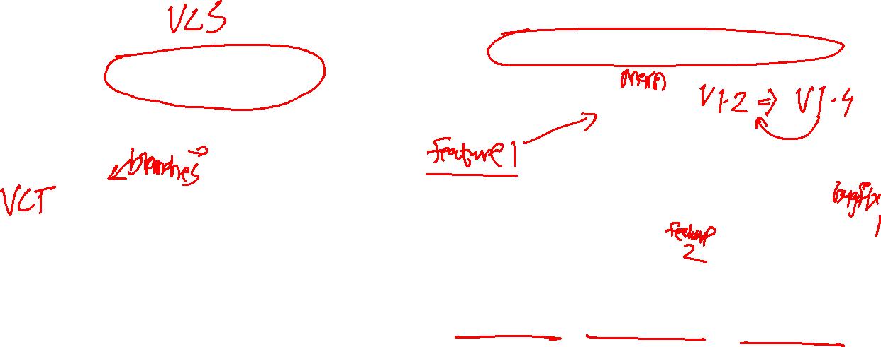

Slide 20

Advantages of Git over other VCST
Free and open source
Speed and Offline
Distributed development
Scalable
Reliable
Secure
Easy Branching

Slide 21
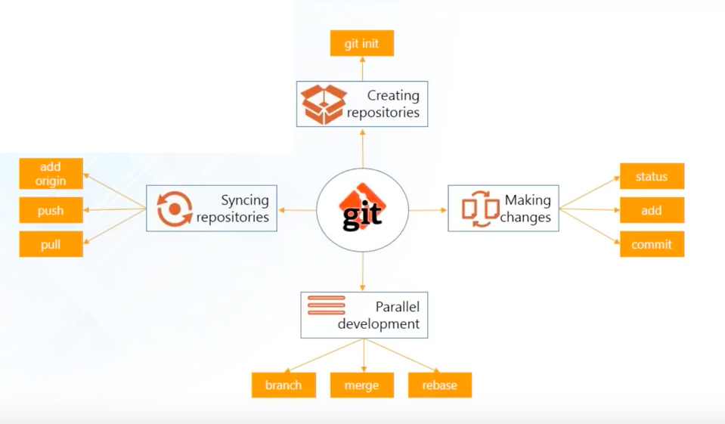

Git Operations & Commands

Slide 22

Create Repository
Create Central repository on GitHub
git init
Install git on your machine and use “git init” to create your local repository
OR
git clone
Download or clone Repository from GitHub

Slide 23
Syncing Repositories
Use git remote add origin <link> to add remote reop.
Pull files to local repo with git pull origin master
After work is done, push your changes into central repo with git push

Slide 24
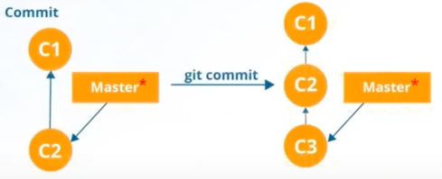

Making changes
git status
Tells you which files are modified and are ready to commit
git add
Lets to add files to index
git commit
It refers to recording the changes you made in your files at given time

Slide 25
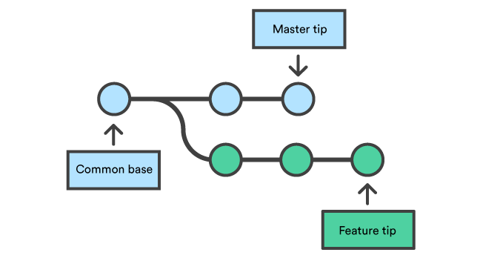

Parallel development - Branching
Branches are pointers to the specific commit.

Slide 26
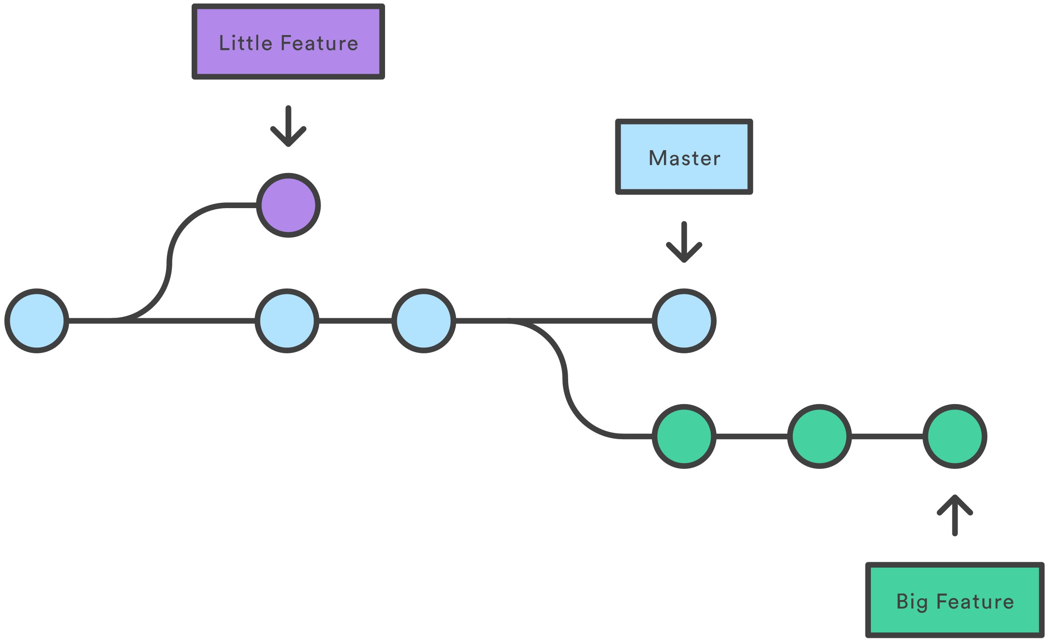
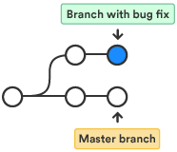
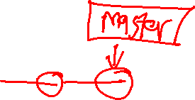

Parallel Development - Merging
Allows to branch off, develop a new feature and combine it back in.

Slide 27
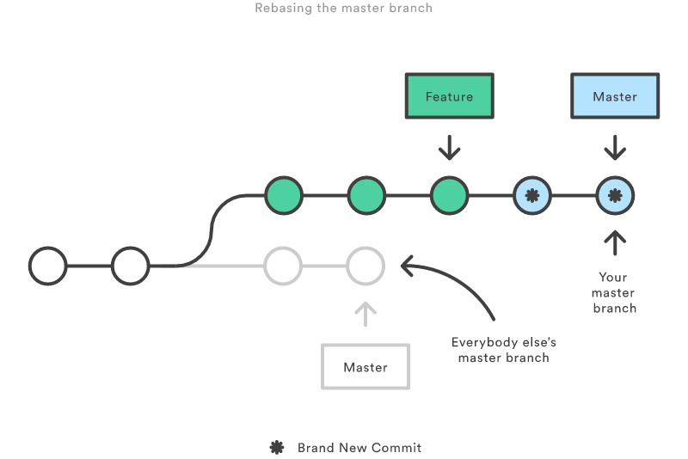
Parallel development - Rebasing
It can be used to make linear sequence of commits

Slide 28
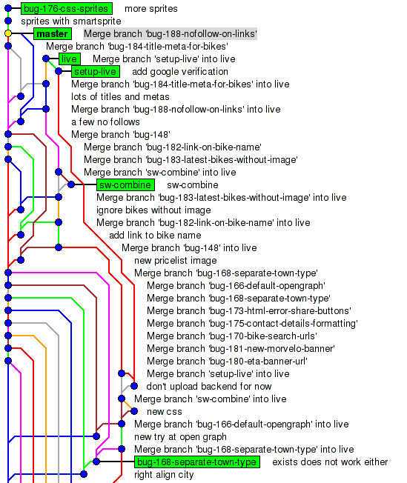


Slide 29
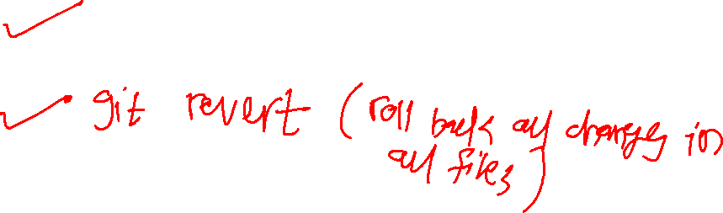
Revert to Previous version
Access log list by typing git log
Copy the first 8 digits of commit ID
Now type git checkout <commit ID> file_name

Slide 30
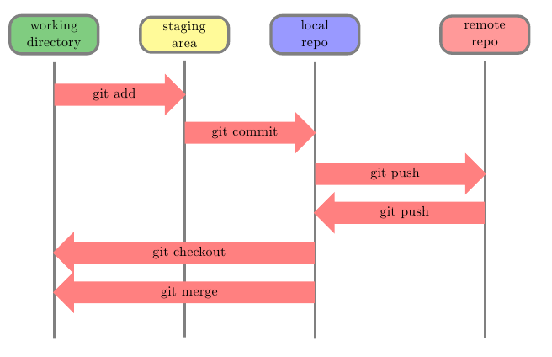



Slide 31
Thank You!

